Slide 1
Finance Calculator
Honghao, Ayush, Qiyu

Slide 2
Inspiration
Inheritance of HW3
Construction of a Calculator that supports the integer-based arithmetic
Simulation of the Texas Instruments’ BA II Plus Calculator
Support for floating-point accuracy, differentials and integrals
Compute the Value of a given kind of Currency
Regression Analysis of Series Data: mean and variance

Slide 3
Design
The Problem to Solve
Interpretation of Arithmetic Expressions
Evaluation of the Result out of the Expressions
Data Structures and Algorithms
Arrays (i.e. T[]), ArrayList<T>, Node<T> (as a BST), Stack<T>
DFS to compute the sub-trees’ values, approaching the final result
Pre-Order Traversal

Slide 4
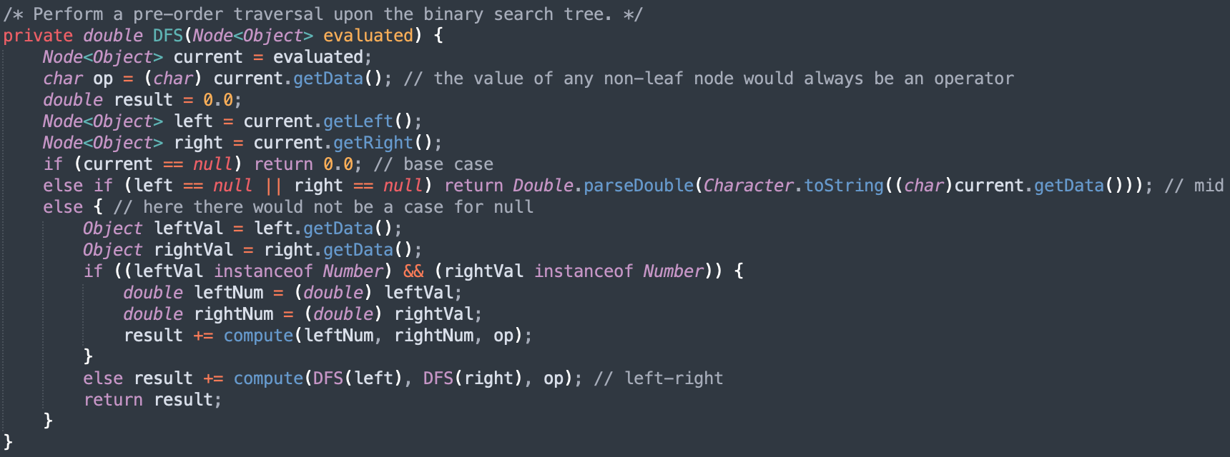
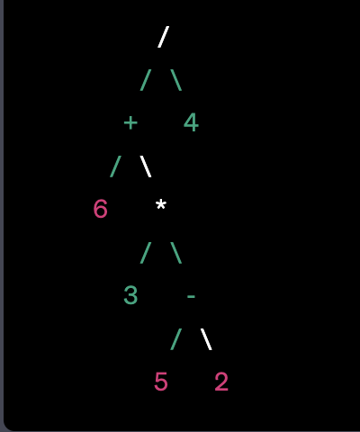
DFS
https://www.cs.usfca.edu/~galles/visualization/DFS.html

Slide 5
Basic Features
Entry of the Expression
Support with Integer Entries containing uneven count of Spaces
Interpretation for the Expression
Distribute the Data by the Priority of operation
High: * and /
Medium: + and –
Low: ( and )
Calculate the Results
Currency Conversion
USD, INR, CNY, JPY, etc.
Use one of the Currency as the Base

Slide 6
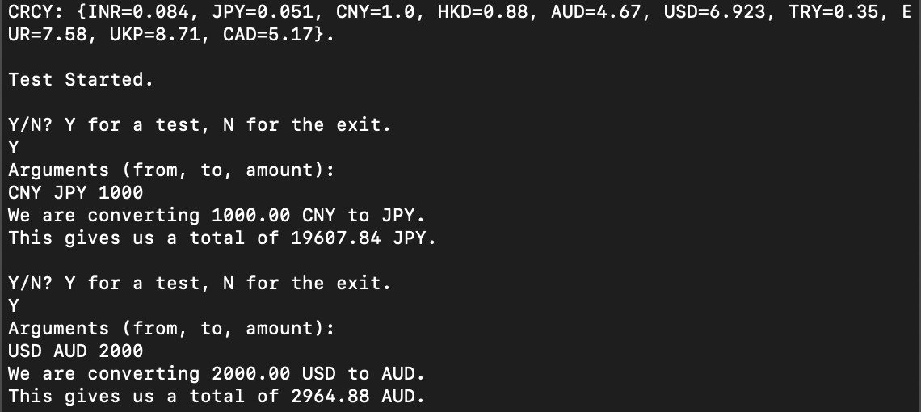
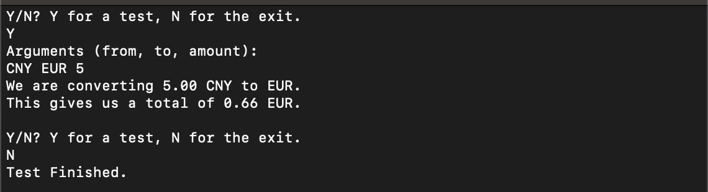
Test Case

Slide 7
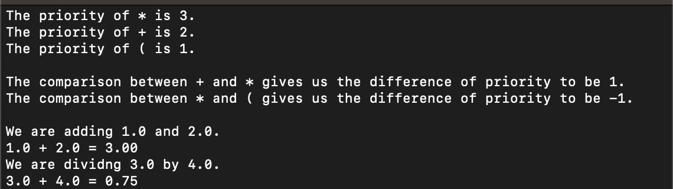
Test Case (Cont’d)
(9 * (7 + (3 * (6 – 4)))) / (5 – (1 + 8))
(9 + 2) * ((4 – 2) * (5 + 3) + 1) – (7 – 5) * ((6 + 3) * (2 – 1) + 4)
(1 + (2 * (3 – 4))) * (5 / (6 + 7))
((1 + 2) * (3 – 4)) / ((5 + 6) * (7 – 8))
(1 + 2) * (3 * 4 – 5)
(2.4 * (4 * (34 – 6 / 2.5) – 5)) - 8

Slide 8
TODO
Entry of the Expression
Support with Floating-Point Entries with unbalanced Spaces
Interpretation for the Expression
Algorithmic Complexity:
Current: expr → RPNExpr & rpn → Stack<Node> → Node → Double
Is there a better one? Potentially to simplify the step from Stack to Node
Robustness Tests:
Entries of expressions that have non-arithmetic notations e.g. AND, OR, XOR
Negative Numbers
The differences between ‘(6 +3 *(5 -2))/ 4’ and ‘(6 +3 *(5 + (-2)))/ 4’
Extra Parentheses when the denominator is negative, even w/o Parentheses
Type Casting
GUI and Financial Features

Slide 9
Reference
Full Code: https://github.com/ZhongQiyu/sp23-cs608-midterm
API of CS608 HW3’s Calculator
W3Schools Online Web Tutorials
Mathematica (https://reference.wolfram.com/language/tutorial/AlgebraicCalculations.html.zh?source=footer)
User Manual of BA II Plus

